Slide 1
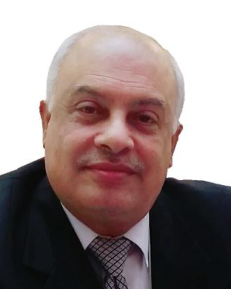
Hennawy Glove Tamponade Ballloon Catheter For Control Of PostPartum Hemorrhage (The Bakri Tamponade Balloon Catheter Analogue )
Muhammad M Al Hennawy
First Consultant Obstetrician & Gynacologist
Ras El Bar Central Hospital ,
Dumyat Specialised Hospital ,
Egypt
01222503011

Slide 2
Postpartum Haemorrhage
Postpartum haemorrhage (PPH) is defined as blood loss of 500ml or more within 24 hours after birth.
It can occur after vaginal or cesarean delivery
PPH is the primary cause of nearly one-fifth of all maternal deaths globally.
Most of these deaths occur during the first 24 hours after birth.
The majority could be prevented through the use of prophylactic uterotonics during the third stage of labour, and by timely and appropriate management.
The use of intrauterine balloon tamponade can potentially avoid surgery or could be used as a temporizing measure while awaiting transfer to a higher level facility.

Slide 3
Uterine Balloon Tamponade (UBT)
It is a medical device
that can be used to
treat Postpartum Hemorrhage
which is unresponsive to uterotonics and uterine massage
It is used
to control haemorrhage due to uterine atony in the upper segment of the uterus and
to control bleeding in the lower uterine segment secondary to placental implantation in the lower uterine segment.

Slide 4
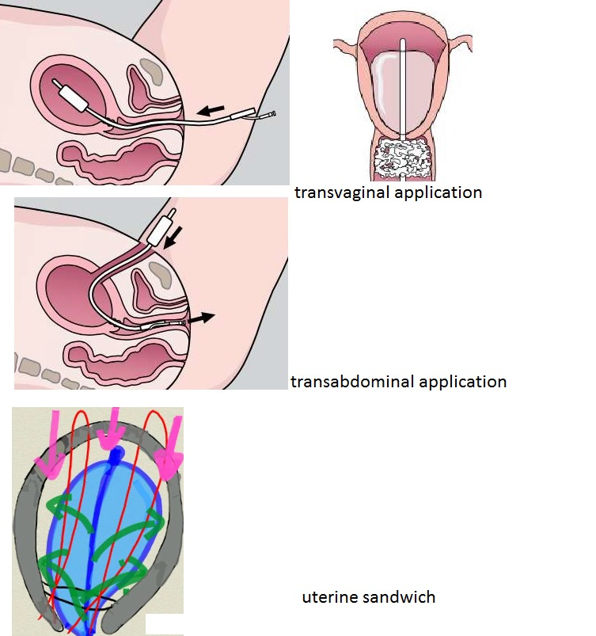
Methods Of Application
1-Transvaginal application (post vainal delivery also
post cesarean delivery or during cesarean after close uterus
then applying the tamponade test before closing the laparotomy site:
allow visualisation of the uterus following inflation )
2-Transabdominal application
Close the uterus first and
then insert the balloon
3-Post uterine compression suture application
( uterine sandwich)
Insert uterine suture
Insert balloon
Close uterus
Inflate balloon
(another method --insert balloon vaginally after insert uterine suture and close uterus and close abdomen)

Slide 5
The Bakri tamponade balloon catheter
It is the first uterine tamponade balloon system designed specifically for the treatment of obstetric hemorrhage
It consists of a silicone balloon (maximum recommended fill volume 500 mL, but volumes up to 1300 mL have been used
It connected to a 24 French silicone catheter 54 cm in length. The collapsed balloon is inserted into the uterus
When filled with fluid, the balloon adapts to the configuration of the uterine cavity to tamponade uterine bleeding.
The central lumen of the catheter allows drainage and is designed to monitor ongoing bleeding above the level of the balloon
The device is intended for one-time use.

Slide 6
The causes of postpartum hemorrhage can be thought of as the four Ts
Tone, 75-90% Uterine atony …placental removal leaves a 20cm diameter wound that continues to bleed if uterine musculature does not contract
and stay contracted
Tissue, Products of conception, blood clots
Trauma , Planned --- Cesarean section , episiotomy
Unplanned -- Vaginal/cervical tear, surgical trauma
Thrombin ,Congenital--- Von Willebrand's disease
Acquired --- DIC, dilutional coagulopathy, heparin

Slide 7
Whatever the cause of PPH, death should be preventable
Active management of the third stage of labor reduces uterine atony and is the mainstay of prevention of hemorrhage
The rapid correction of hypovolumia with crystalloid and red cells is the first priority of management of PPH.
Uterotonic drugs, such as oxytocin or ergometrine, are used as prophylaxis and for controlling PPH

Slide 8
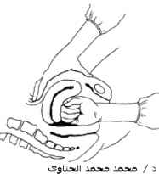
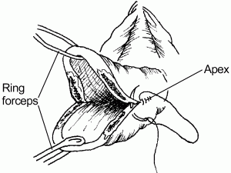
Management Steps in Primary PPH
Call for help
resuscitate
search for cause
bimanual compression, examine placenta, examine and repair lower tract trauma
uterotonics
oxytocin,
ergometrine,,
misoprostol.

Slide 9
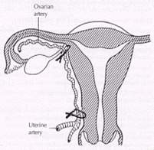
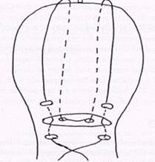
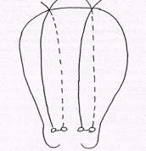
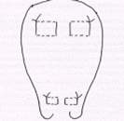
Unresponsive Uterine Bleeding
Tamponade techniques
gauze
balloons , condom/glove with Infiltration of placental bed with vasoconstrictors
Laparotomy
conservative
Vessel ligation ( uterine , ovarian , hypogastric )
Uterine sutures -- Vertical full thickness sutures
- Compression Suture (B-Lynch) 1997
- Modified B-Lynch (Hayman ) 2002
- Horizontal full thickness sutures
- Square Suture 2000
- figure of eight
- Combination of sutures
hysterectomy is the procedure of last resort, and a few patients really need it to save their lives
Embolization are effective methods for controlling intractable hemorrhage

Slide 10
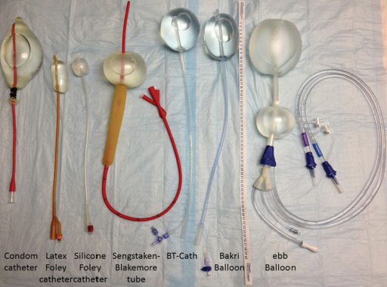
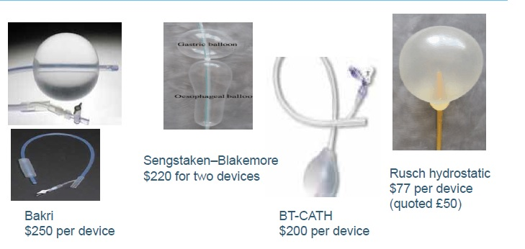
Tamponade Techniques
Uterine gauze
Uterine Balloons
- Early Balloon 1951
-Sengstaken-Blakemore tube ( Tamponade Test ) 2003
- Sengstaken-Blakemore tube 2005
-Rüsch urologic hydrostatic balloon 2001
- St. Bartholomew’s catheter
- J- SOS Bakri tamponade balloon 2001
- Multiple foley’s catheters
- Eid Balloon (El Menia , Egypt ) 2004
- surgical glove 2004
- condom : Shivkar’s balloon pack ( india )1981
: Sayeba’s balloon catheter (Bangladesh ) 2003
: Hennawy’s condom balloon catheter (Rass el barr ) 2005
: “CG Balloon” (CG is our state of Chhattisgarh in India).2016
-finger glove: Hennawy’s finger balloon catheter (rass el barr – egypt ) 2005
- Glove :Hennawy,s Glove Balloon catheter(rass el barr – egypt) 2018
. Vaginal guaze
. Vaginal balloons : Hennawy’s vaginal condom balloon catheter plus Abdomnal binder(2005)

Slide 11
As per WHO recommendations,
the use of intrauterine balloon tamponade (UBT) is recommended for the treatment of PPH due to uterine atony if women do not respond to uterotonics
FIGO also included uterine balloon tamponade as a recommended second-line intervention for the treatment of PPH
The successful outcome of balloon tamponade is reported to be 80–100 %
This high efficacy avoids surgery which is often delayed or may be unavailable thereby costing the women her life.
Intrauterine balloon may also be used as a temporizing measure while awaiting transfer or to resuscitate her.

Slide 12
Indication Of Uterine Tamponade Balloons (UTB)
When PPH that occurred as a result of atonicity
When PPH that occurred as a result of morbid adhesion (accreta) could not be controlled by uterotonics or a surgical procedure.
To control postpartum hemorrhage resulting from a low placental implantation
In patients who were in shock due to massive hemorrhage, a uterine balloon was introduced immediately without prior medical management
Haemorrhage from the placental bed after removal of the ectopic Isthmico-cervical pregnancy by curettage
It is also used for repositioning of inverted uterus.
When temporary control of PPH is needed before referring the client to a higher level of care

Slide 13
Contraindication Of Uterine Tamponade Balloon
Heavy arterial bleeding requiring surgical exploration or angiographic embolization
Cervical cancer
Congenital uterine anomaly (Successful use of balloon tamponade in the management of postpartum hemorrhage in a case of bicornuate uterus)
Uterine distorting pathology (leiomyoma)
Suspected uterine rupture
Purulent infection of the vagina, cervix, or uterus
Allergy to balloon material ( rubber/latex products, such as the Rusch balloon , the condom and glove catheter )
Disseminated intravascular coagulation (DIC)
DIC is listed as a contraindication for balloon tamponade given the complete lack of clinical data. However, theoretically, it can be used to decrease the volume of bleeding and gain time to replenish blood products in preparation for more invasive surgical techniques.

Slide 14
Advantages Hennawy’s Glove Balloon Catheter
Avaliable component in theatre room
Easy made
with minimal training
Very cheap price (less than one dollar)
Easily inserted by the physician as minimally invasive treatment option
The risk of uterine perforation may be lower.
Quickly ascertain effectiveness.
Able to gauge ongoing blood-loss through inner lumen.
Easily removed without need for separate surgical procedure.
Preserving the mother’s ability to bear additional children.
It can be a life-saving intervention, especially in low-resource settings where blood transfusion and surgical facilities may not be available

Slide 15
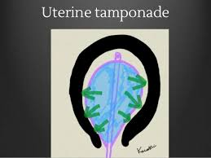
Mechanism Of Action Of UTB
1. Increased intrauterine pressure, which becomes superior to capillary blood vessels pressure
2. Compression of the bleeding site by the inflated glove
3. Contractions induced by the presence of the glove inside the uterus (due to the release of prostaglandins?)
4-Hydrostatic pressure effect of the balloon on the uterine arteries.

Slide 16
Preparation of Hennawy’s Glove Balloon Catheter
It is prepared manually with all aseptic precautions

Slide 17
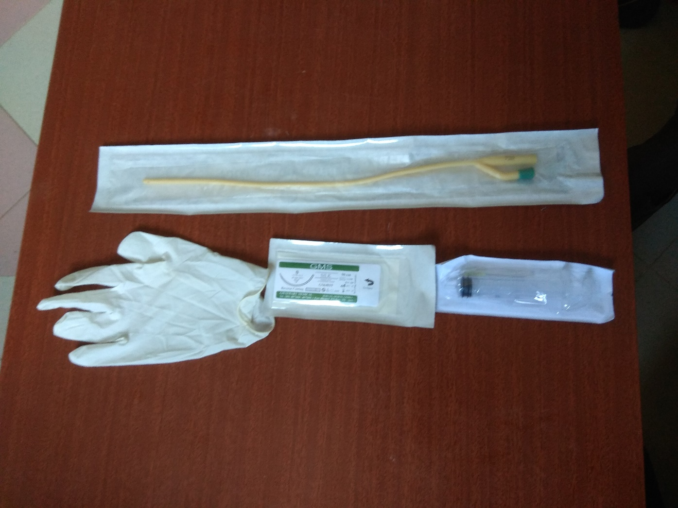
A Glove size 8 ,Foley’s catheter size 22-24, silk thread , syringe 50 cc ,saline bottle

Slide 18
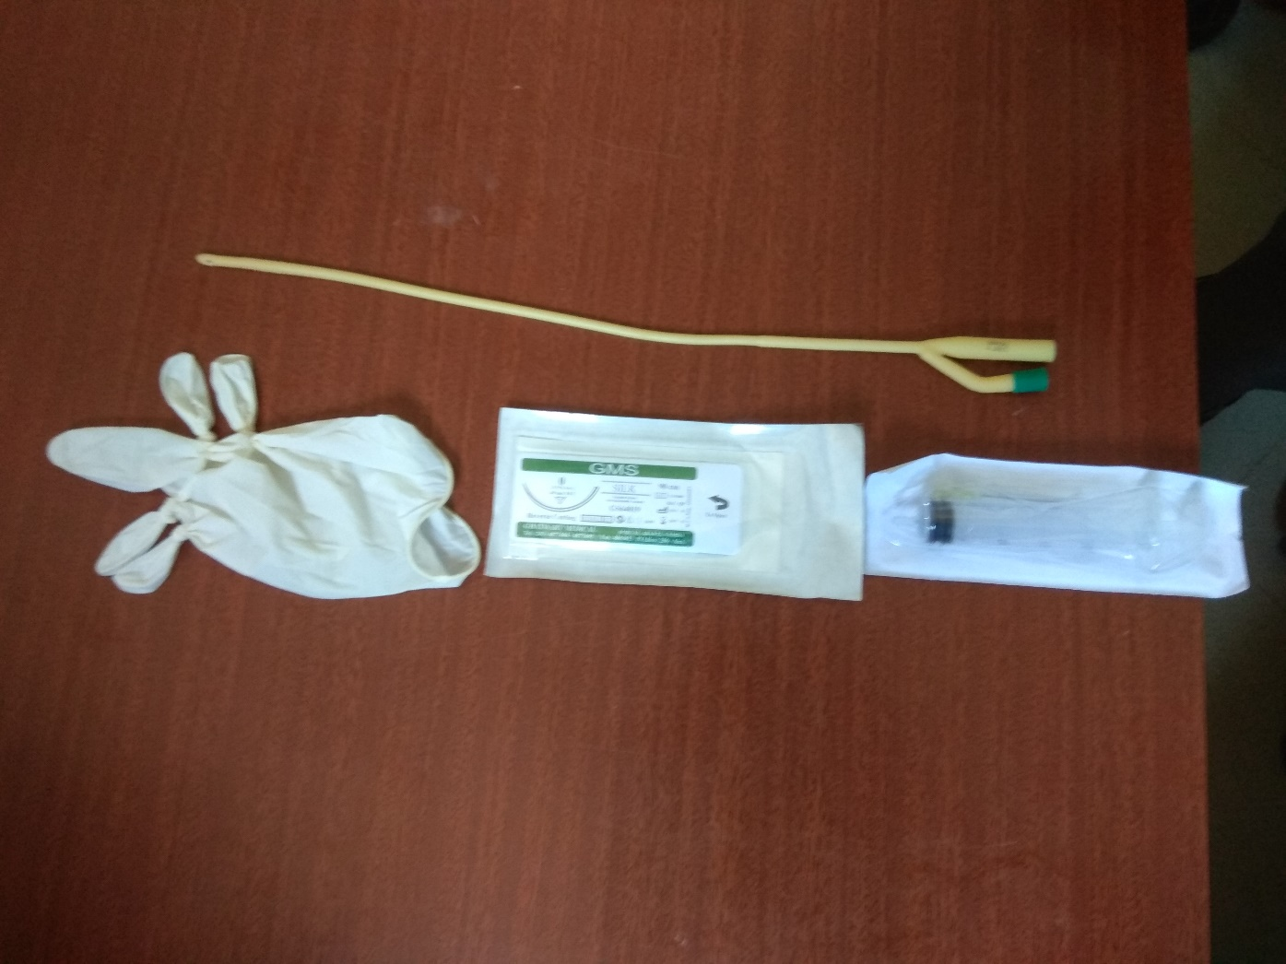
Tie peripheral four fingers of glove , leaving middle finger

Slide 19
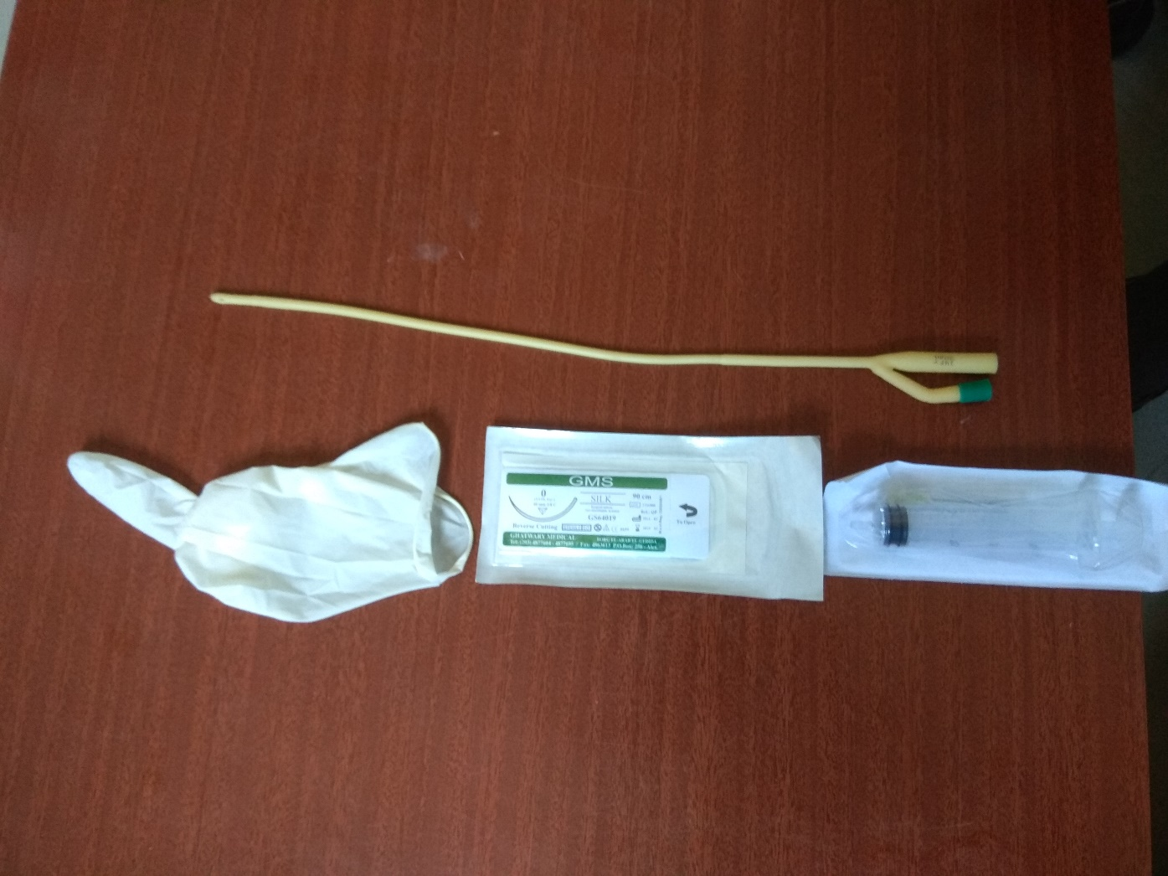
Invert the Glove

Slide 20
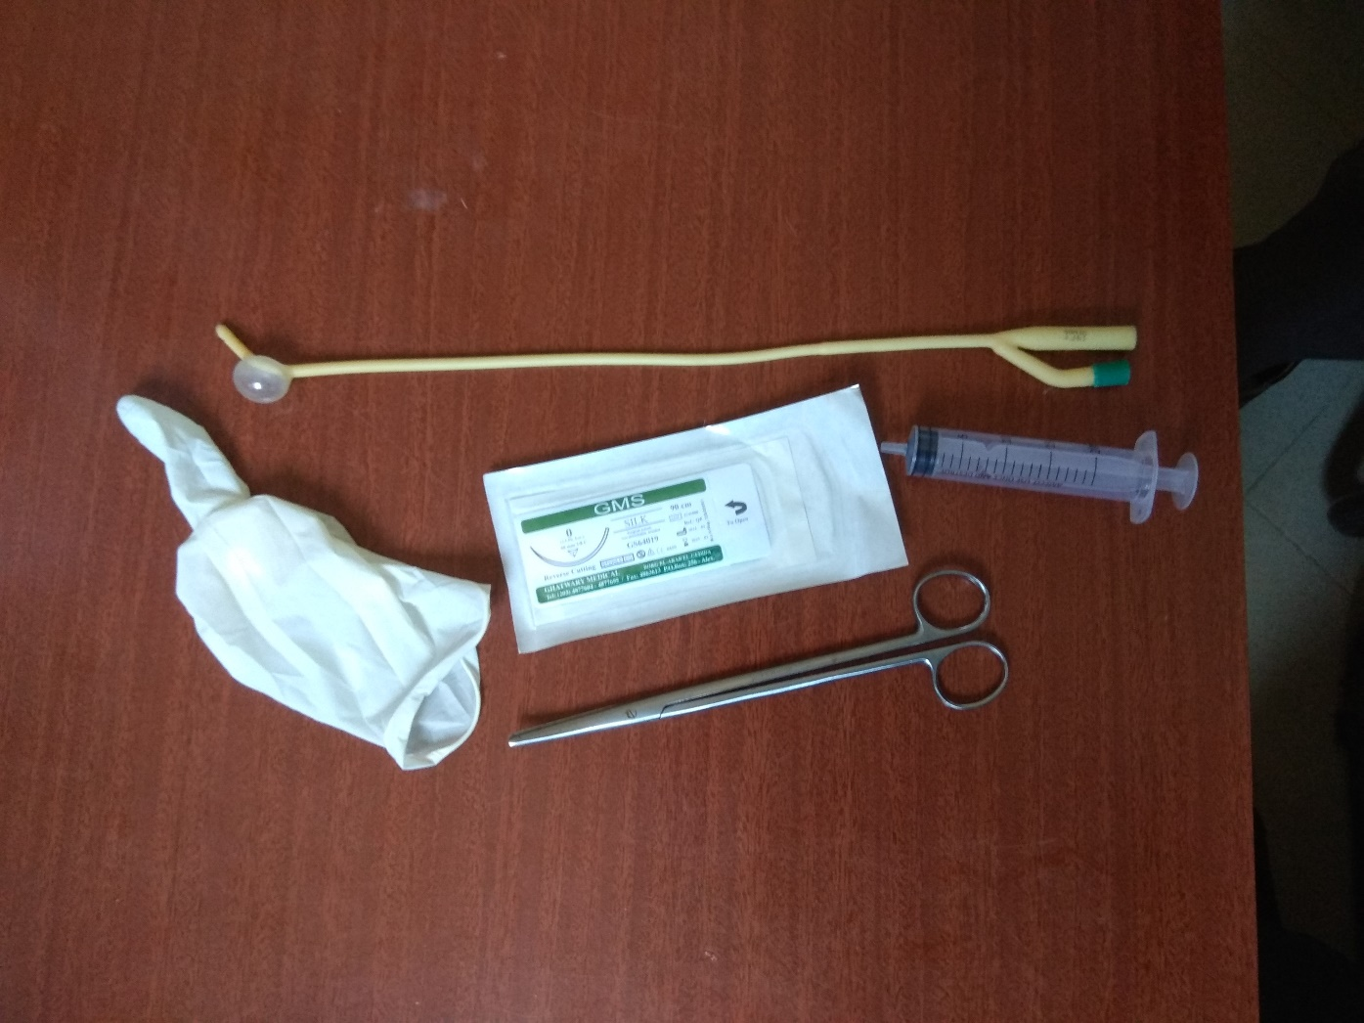
Excise (not merely incise) the bulb of the catheter after inflating it with air

Slide 21
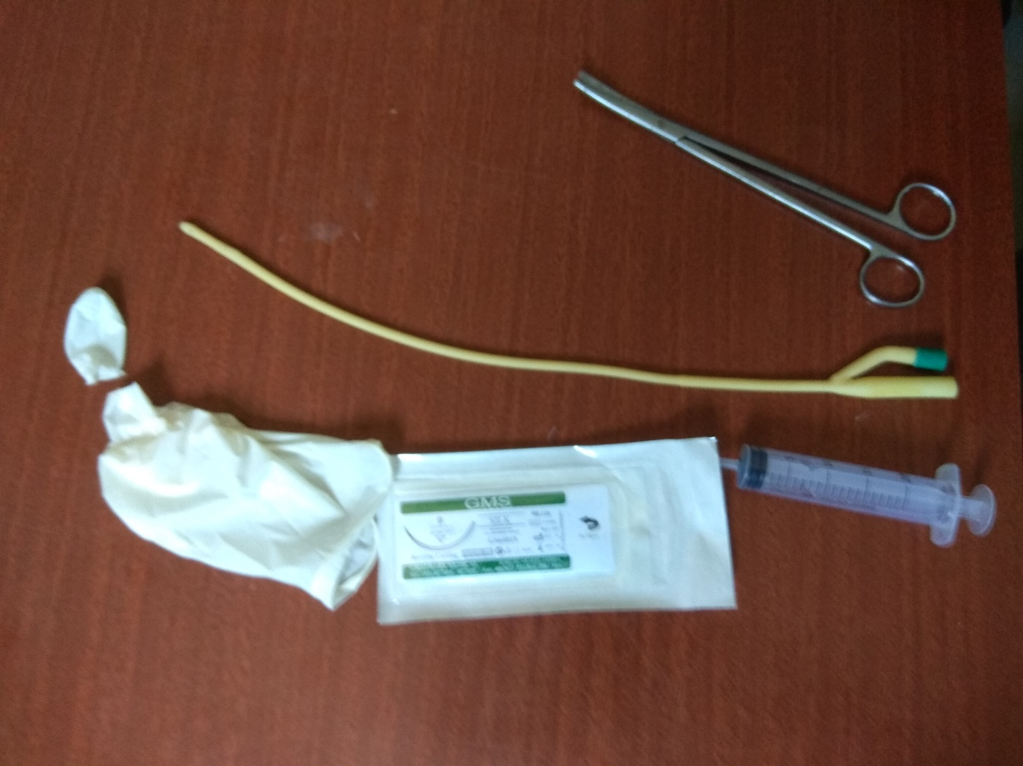
Cut half of middle finger

Slide 22
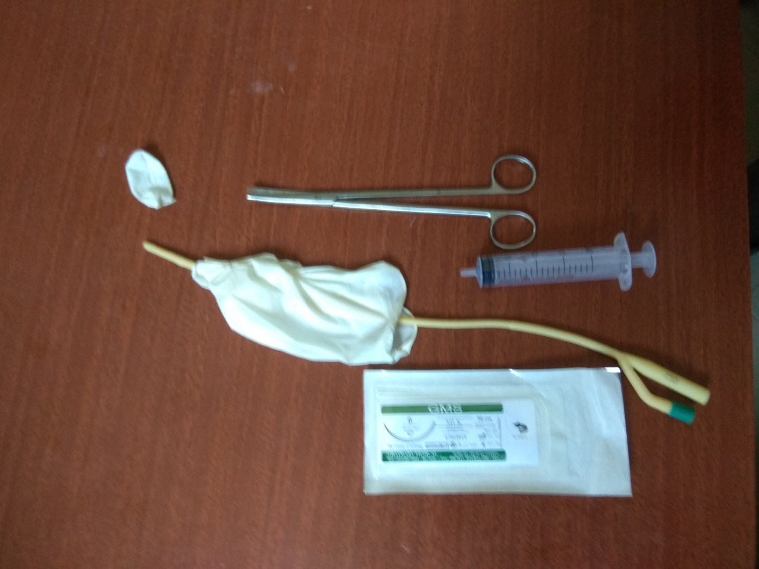
Insert foley’s catheter inside middle finger

Slide 23
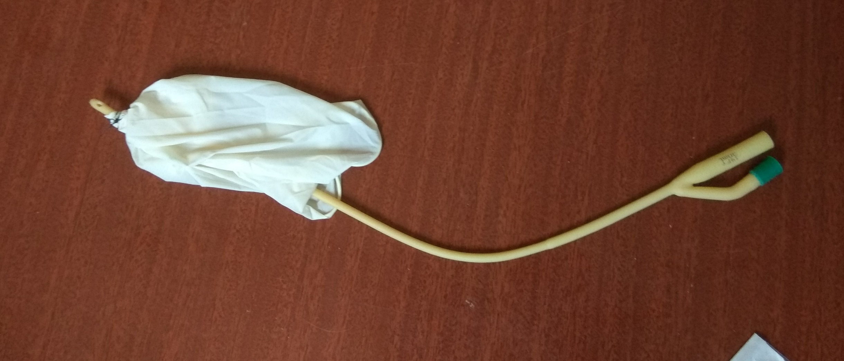
Tie middle finger over foley’s catheter bellow its tip and above bulb by 2 silk threads

Slide 24
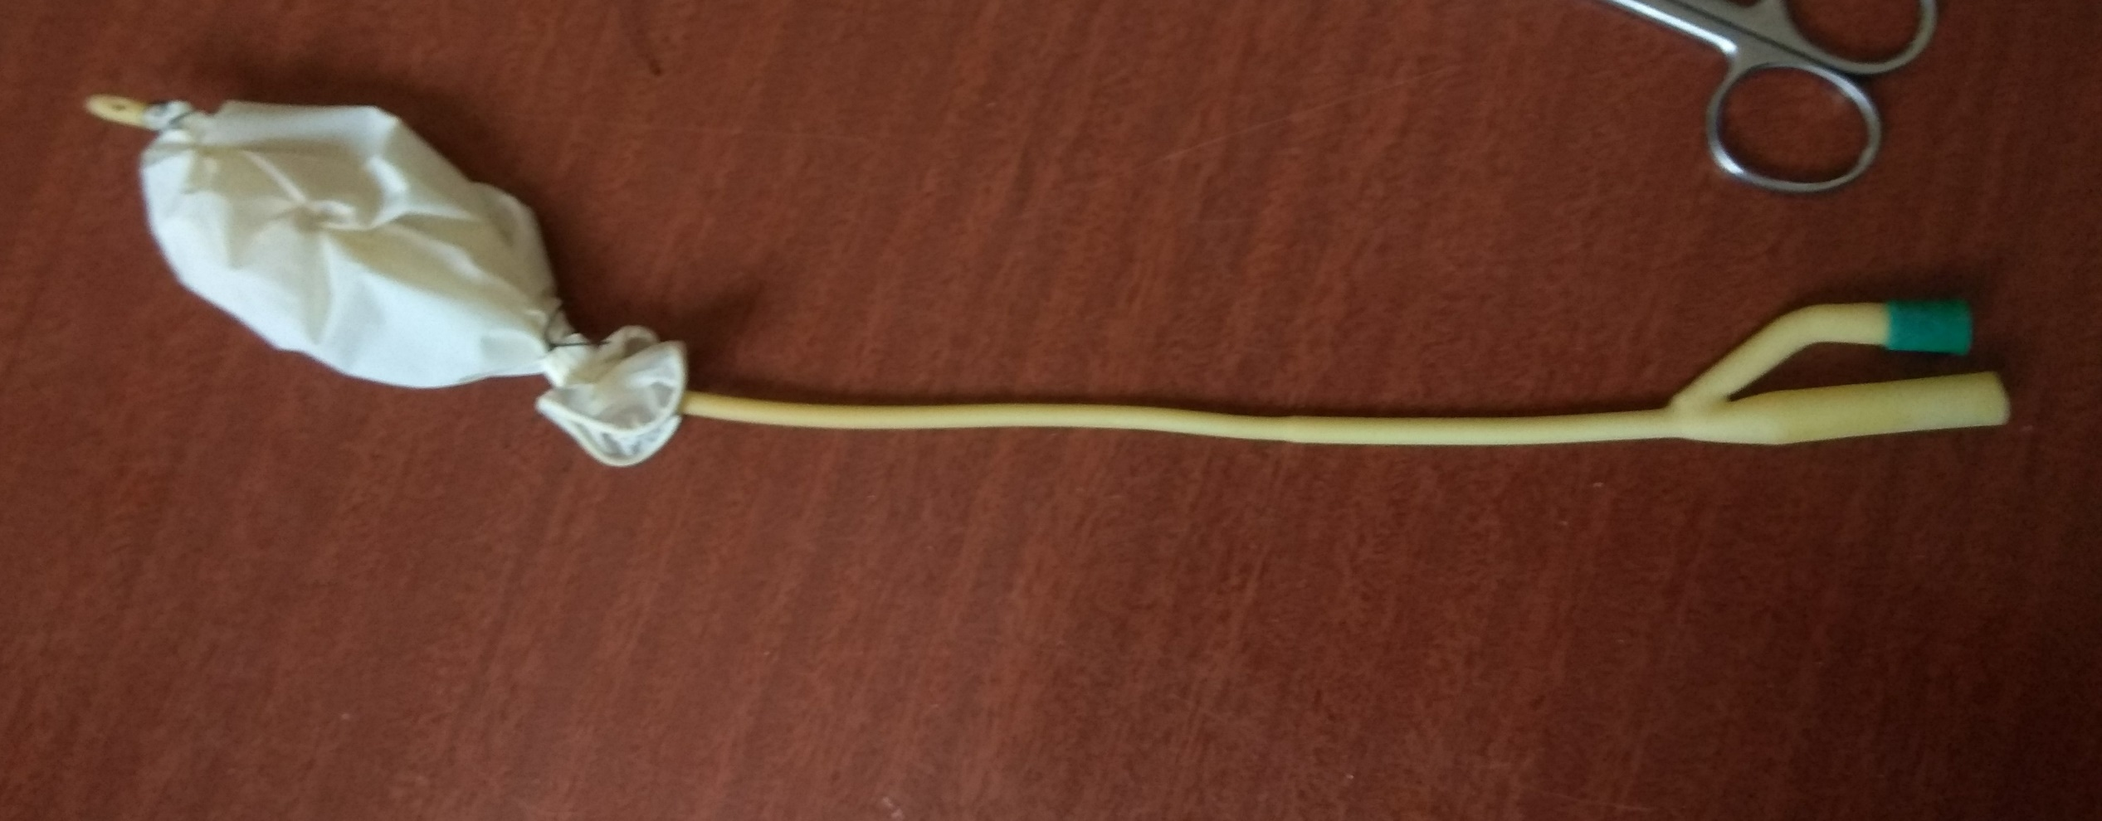
Tie end of glove at distal third of shaft of foley’s catheter by 2 silk threads (all foley’s shaft length = 38 cm)

Slide 25
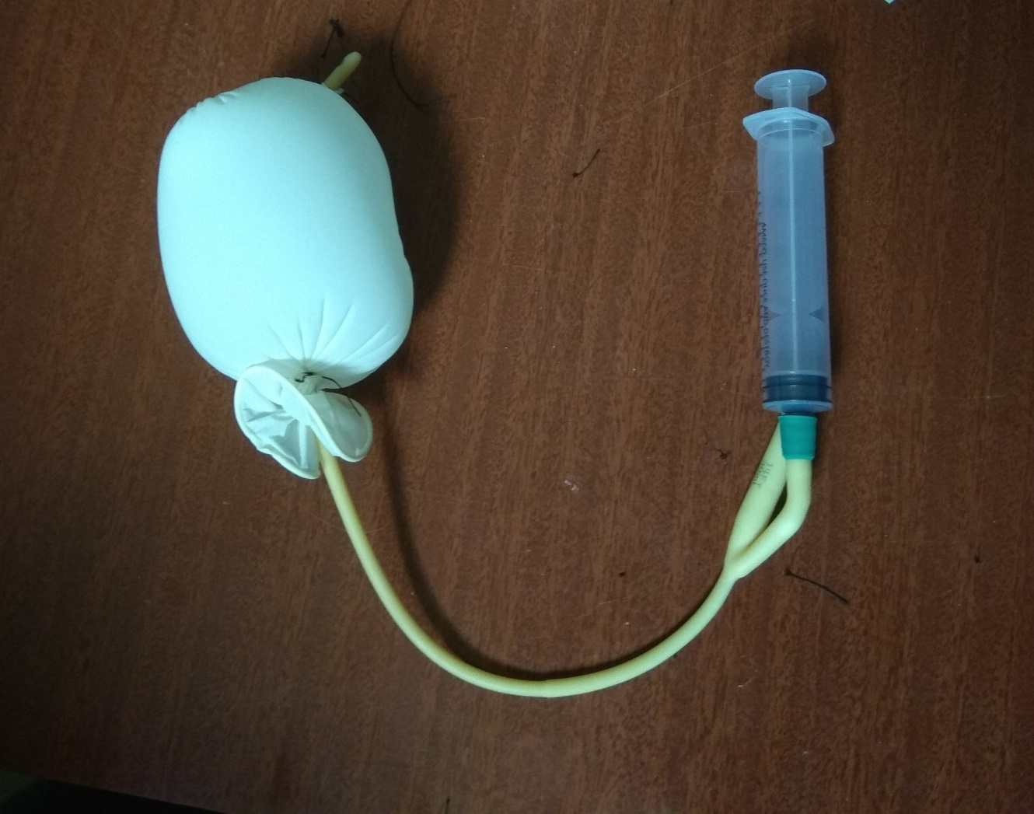
Inflate with warm saline

Slide 26
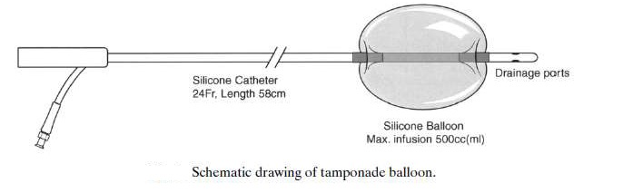
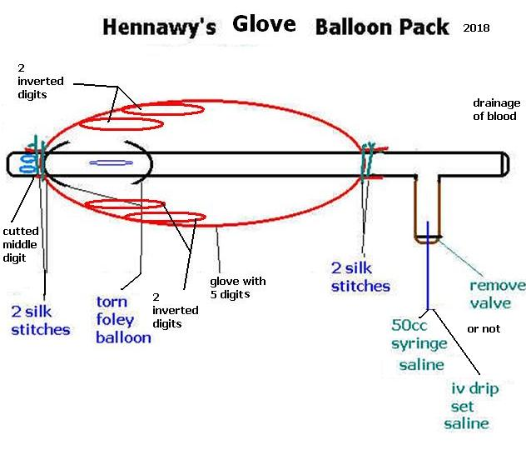

Slide 27
Technical Considerations
All procedures for management of postpartum hemorrhage be performed on the labor and delivery unit,
With an operating room available if an emergency laparotomy becomes necessary.

Slide 28
Procedure Planning
Prior to the procedure,
A bedside ultrasound should be used to help assess the uterine cavity to rule out retained product of conception and to assess the angulation and shape of the uterine cavity to help balloon catheter placement.

Slide 29
Complication Prevention
Complications related to intrauterine balloon placements are very rare but potentially include perforation of uterus during placement or uterine rupture during inflation
Cervical trauma due to inflation at an incorrect location. However, these complications have not been reported in the postpartum uterus.
Infection has been reported, but determining whether it is related to the balloon placement is difficult.
To avoid potential risk of air embolism, the balloon should not be insufflated with air or carbon dioxide.

Slide 30
Ensure the uterus is clear of any retained placental fragments, blood clot, arterial bleeding or lacerations before
Insert balloon catheter under spinal, epidural or general anaesthesia in theatre.
Insert Foley catheter in urinary bladder prior to the procedure.
Clean cervix and vagina with betadine
Introduce vaginal speculum and using sponge forceps, insert balloon catheter transvaginally into the uterine cavity under guided ultrasound.

Slide 31
Methods of Vaginal Application
Blind Method
Under Vision Method
Under Ultrasound Guidance

Slide 32
Blind Method
Introduce your hand with device
Or with a long forceps
Then fill till no space
Go out with your hand or a long forceps
Continue filling till Bleeding reduced considerably, further inflation was stopped

Slide 33
Under Vision Method
Grasp Anterior and Posterior lips of cervix with 2 ovum forceps
Then introduce it
Fill till balloon appears at cervix Bleeding reduced considerably, further inflation was stopped

Slide 34
Under Ultrasound Guidance
Insert the catheter transvaginally under ultrasound guidance to:Assure that the uterus is clear of any retained placental fragments, arterial bleeding, or lacerations.
Determine approximate uterine volume by ultrasound

Slide 35
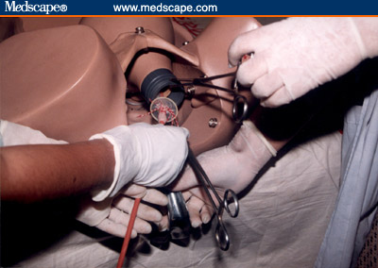
Methods of vaginal Application
Blind Method
Introduce your hand with device
Or with a long forceps
Then fill till no space
Go out with your hand or a long forceps
Continue filling till Bleeding reduced considerably, further inflation was stopped
Under Vision Method
Grasp Anterior and Posterior lips of cervix with 2 ovum forceps
Then introduce it
Fill till balloon appears at cervix Bleeding reduced considerably, further inflation was stopped
Under Ultrasound Guidance
Insert the catheter transvaginally under ultrasound guidance to:Assure that the uterus is clear of any retained placental fragments, arterial bleeding, or lacerations.
Determine approximate uterine volume by ultrasound

Slide 36
Method of TransAbdominal Application
Determine that the uterus is clear of any retained placental fragments, arterial bleeding, or lacerations.
Determine uterine volume by intraoperative direct examination.
From above (via access of the cesarean incision), put the glove partly in the uterine cavity
Have an assistant pull the Foley catheter through the cervix and the vaginal canal and make sure the glove is entirely in the uterine cavity.
Close the incision per normal procedure, taking care to avoid puncturing the glove while suturing.
Inflate the glove by connecting end of catheter to syringe with saline.

Slide 37
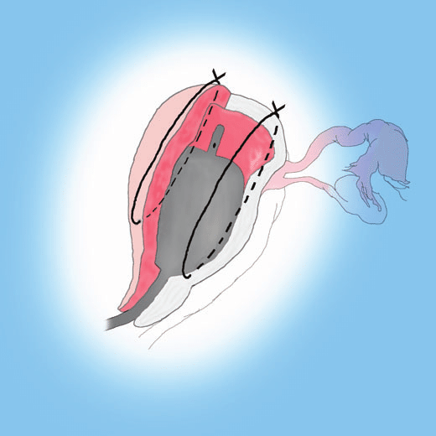
Post uterine Compression Suture Application (Uterine Sandwich' Technique)
It is combining Hayman external compression suture with intrauterine Hennawy Glove Tamponade Balloon Catheter
(uterine incision was already present, the Hennawy Glove balloon was introduced abdominally and the caudal end pulled through the cervix into the vagina by an assistant. Only when the compression sutures failed to control bleeding was the balloon inflated)
A combined method of B-Lynch suture and the intrauterine balloon has also been successfully used in preventing PPH in placenta praevia.

Slide 38
Inflate Until
Uterine Balloon Tamponade is inflated of warm 0.9 % sodium chloride through one-way valve of the catheter by syringes in the alternating repetitive manner until
1- the balloon conforms to the shape of uterus and the uterine fundus become firmly palpable
2-bleeding was controlled ( if there is no bleeding through the cervix or through the drainage channel of the balloon catheter)
3-until balloon visible in the cervix lumen
4-Under guidance of ultrasound
But
minimal amount of uterine distension to accomplish haemostasis
over-inflating’ the balloon- distension of the uterus: significant pain.
-theoretical concern of uterine rupture

Slide 39
The test result
PPH involving a dilated cervix {balloon is insufflated, it will expand to fit the least resistant space the vagina).
Positive tamponade test needs to be demonstrated prior to placement of the vaginal pack. Otherwise, there is a danger that the pack will obscure any continuing bleeding leading to a delayed diagnosis of ineffective tamponade.
It considered successful
if there is no bleeding through the cervix or through the drainage channel of the balloon catheter.
the tamponade test is unsuccessful
If bleeding continues within 15 minutes of UBT insertion, and surgery is needed.
Document amount of fluid in balloon.
Apply gentle traction to balloon and tape balloon to the woman’s inner thigh to maintain tension.

Slide 40
To keep the Uterine balloon in situ
the vaginal cavity was filled with roller gauze and finally a sanitary pad..
or the vaginal cavity was filled with another inflated Glove placed in the vagina
Connect the drainage port to a fluid collection bag to monitor hemostasis after the balloon is inflated

Slide 41
Management following insertion
An intravenous drip containing oxytocin was kept for at least 6 h after the procedure was performed to maintain the uterus contracted over the inflated balloon (20 iu in 500 saline every 4hours).
Temporary external compression of the uterus (Firm pressure was also applied by hand to the outer and inner side of uterine cavity )
Observations
Hourly urine output, blood pressure, pulse rate, respiratory rate, oxygen saturation, fundal height and vaginal blood loss (through the lumen of the catheter) until stable.
Temperature every two hours (every hour if blood transfusion in progress).
A strict fluid balance chart must be kept with input/output recordings made at least hourly.
The estimated/weighed blood loss from the postpartum haemorrhage must be included to ensure this is accounted for when making decsions about fluid balance.

Slide 42
Antibiotics
Administer Triple IV antibiotics
(ampicillin [or amoxycillin] 2g IV initial dose then 1g IV every 4 hours,
gentamicin 5 mg / kg IV as a single daily dose,
metronidazole 500 mg IV every 12 hours)
until after removal of the balloon catheter

Slide 43
Removal Hennawy’s Glove Balloon Catheter
.Leave balloon tamponade in place for 6 to 24 hours to allow time for blood transfusion and coagulopathy correction
Remove and count vaginal packing/sponges
.deflate the balloon ( stepwise removal) in two stages
1–deflated gradually over (10 minutes) half the 0.9 % sodium chloride
and
if no significant bleeding after 30 minutes,
2- withdraw the remaining volume to deflate it
Using an appropriate size syringe, aspirate the contents of the balloon until fully deflated.
(Or deflate 200ml every hour)
Verify that the the original volume inserted in the balloon was removed.
Gently retract the balloon from the uterus and vaginal canal and discard.
. Continue to observe the woman for any active bleeding
Re-inflate to previous level if bleeding reoccurs while deflating. (Persistent or recurrent bleeding is an indication to proceed with another treatment option.)
Re-inflate as a temporary measure and reconsider surgical intervention

Slide 44
Advantages Hennawy’s Glove Balloon Catheter
The catheter has several benefits:
Avaliable component in theatre room
Easy made
safe
with minimal training
Easily inserted by the physician as minimally invasive treatment option
It can also be inserted at time of cesarean from above
The risk of uterine perforation may be lower.
Quickly ascertain effectiveness.
Able to gauge ongoing blood-loss through inner lumen.
Easily removed without need for separate surgical procedure.
preserving the mother’s ability to bear additional children.
It can be a life-saving intervention, especially in low-resource settings where blood transfusion and surgical facilities may not be available

Slide 45
Summary
•PPH is a potentially life-threatening event.
•In the majority of cases, relatively simple methods are used to avert a disaster, although these are not always employed.
•Uterine tamponade using intrauterine balloons is an effective tool in the management of PPH {90% cases were successful}
•Balloon tamponade is simple to arrange and with minimal adverse effects: a familiar component for the management of PPH

Slide 46
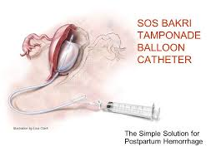
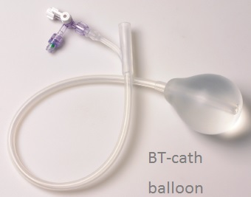
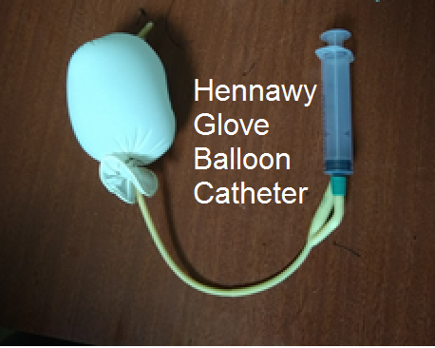
US Food and Drug Administration
Bakri tamponade balloon catheter and the BT-cath balloon are the only such devices approved by the US Food and Drug Administration for this application.
However,
In settings where these are unavailable,
Other balloons can be used to achieve a similar effect as Hennawy’s Glove Balloon Catheter .

